Slide 1

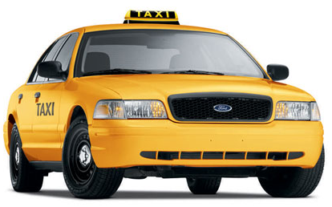

Taxi! Location-based Predictive Modelling
Team
Sarah Hewitt

Slide 2
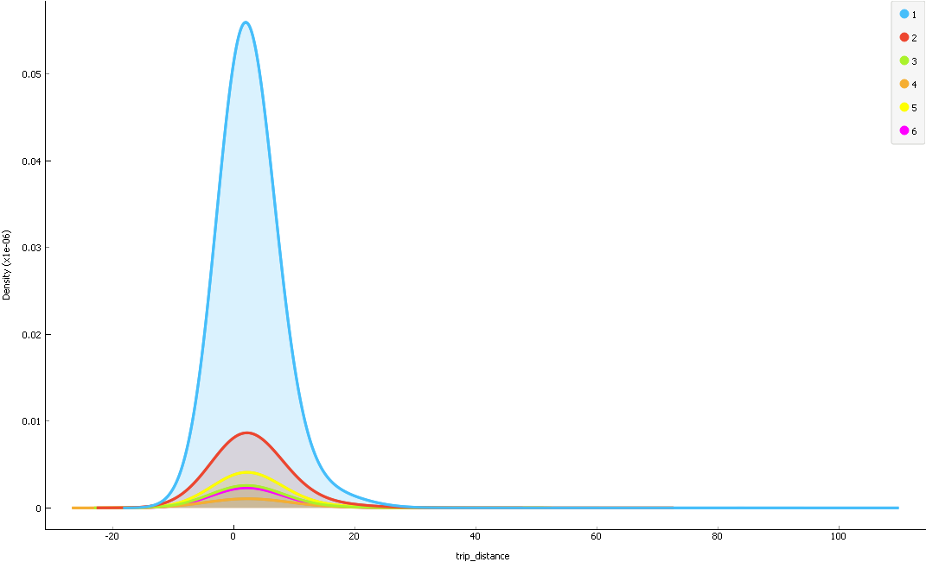
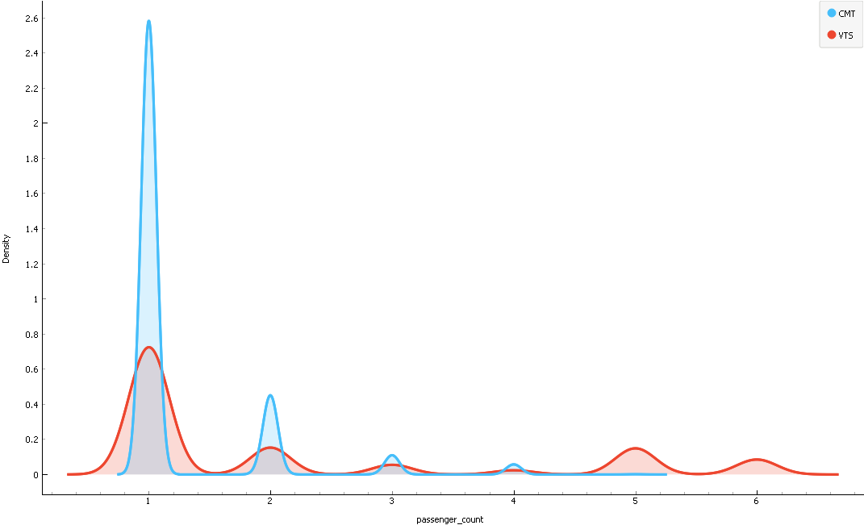
What does the data tell us?
No. of passengers:
…and short trips of around a half a mile.
Note: This data is based on a sample of 1% taken from January 2013.
Unsurprisingly, most journeys were single passenger….

Slide 3
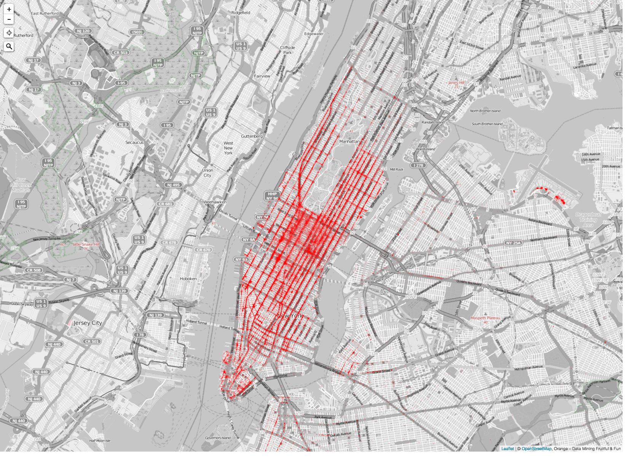
What does the data tell us?

Slide 4
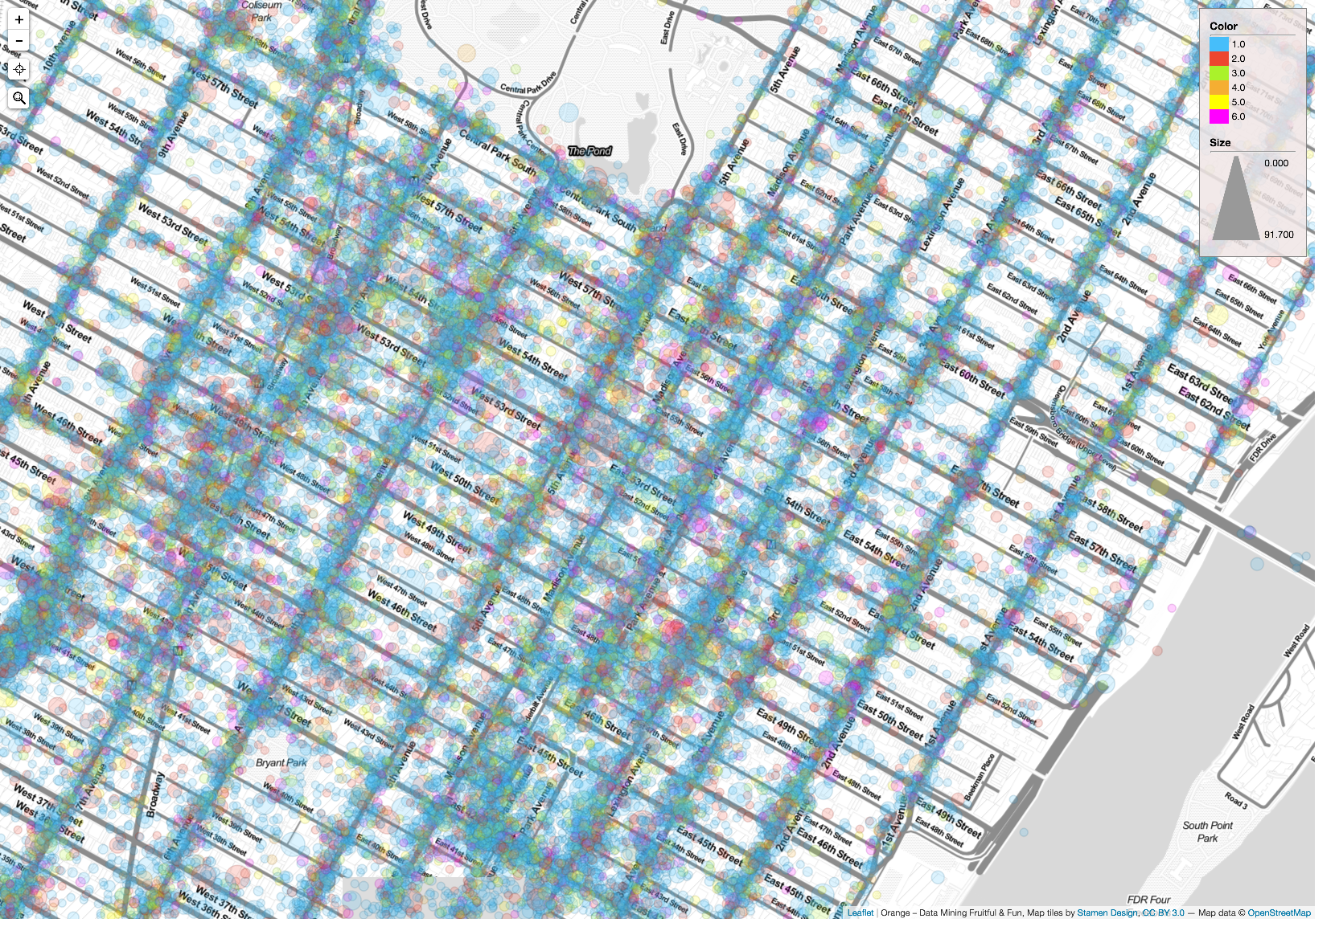
What does the data tell us?
Pick up locations: Number of passengers (1-6) in the vehicle (colour), trip time (size).

Slide 5
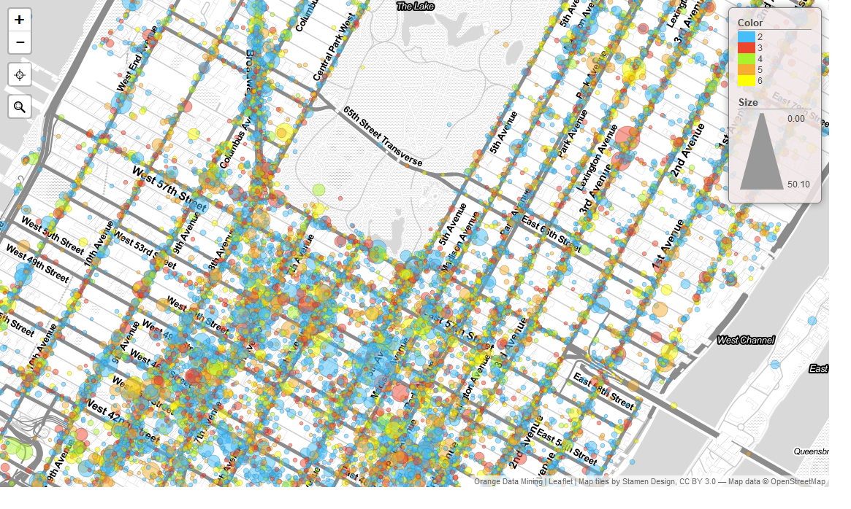
What does the data tell us?
Pick up locations: Number of passengers (2-6) in the vehicle (colour), trip distance (size).

